Slide 1
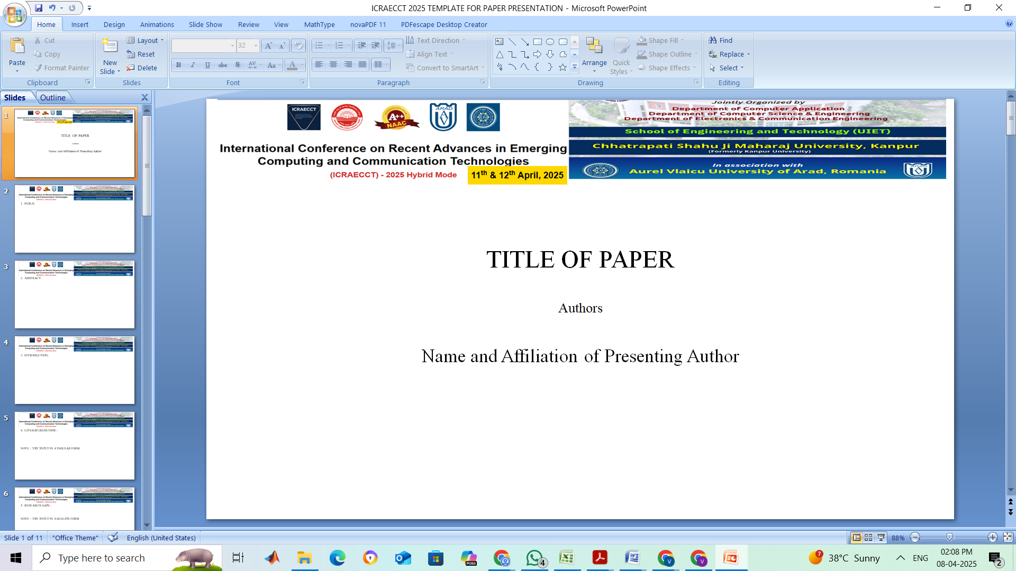
Fusion of Yoga and AI: A Framework for Emotion and Stress Monitoring
Prof. Dr. Raghav Mehra, Tanisha Nagpal, Aaditya Singh, Disha Saini, and Ishaan Shandilya
Ishaan Shandilya, Chandigarh University, Punjab, India

Slide 2
1. INDEX:
Abstract
Introduction
Literature Review
Research Gaps
Proposed Methodology
Results & Discussion
Comparative Analysis
Conclusion & Future Work
References

Slide 3
2. ABSTRACT:
This research presents an innovative AI-based framework that integrates Yoga practices for real-time emotion and stress monitoring. Using self-reported data and Yoga session metrics, the system leverages CNN and MobileNetV3 models to make personalized predictions on emotional states. Unlike sensor-based systems, it offers a non-invasive, scalable, and accessible solution that bridges ancient wellness practices with modern AI. Evaluation results show promising accuracy and responsiveness, demonstrating its real-world applicability for enhancing mental well-being.

Slide 4
3. INTRODUCTION:
Mental health challenges are on the rise, demanding accessible and effective solutions.
Yoga promotes physical and emotional balance through breathing and mindfulness.
AI can quantify subjective well-being by analyzing mood, behavior, and posture data.
This research fuses Yoga with AI to create a stress and emotion monitoring framework using CNN and MobileNetV3.
Focus: Real-time, cost-effective, mobile-friendly mental health insights.

Slide 5
4. LITERATURE REVIEW :
Author(s) | Focus Area | Key Contribution
Duppala et al. (2024) | Deep learning in yoga pose recognition | Pose recommendation using CNN & heuristics
Mitse et al. (2024) | AI & neurotech in mental well-being | Breathing-based emotion control via AI & VR
Deepak K. et al. (2020) | CNN for yoga classification | Posture detection through skeletal keypoints
Kumar et al. (2023) | Yoga-82 dataset | Enhanced fine-grained classification
Narayanan et al. (2021) | PoseNet/OpenPose in yoga | Real-time corrections using CNNs

Slide 6
5. RESEARCH GAPS :
Lack of integration between posture correction and emotion detection.
Dependence on expensive wearables limits accessibility.
Existing systems are static and lack real-time feedback.
Limited personalization based on individual Yoga practice metrics.
Inaccurate emotion detection in varying environments.
No unified AI framework tailored to Yoga-specific emotional outcomes.

Slide 7
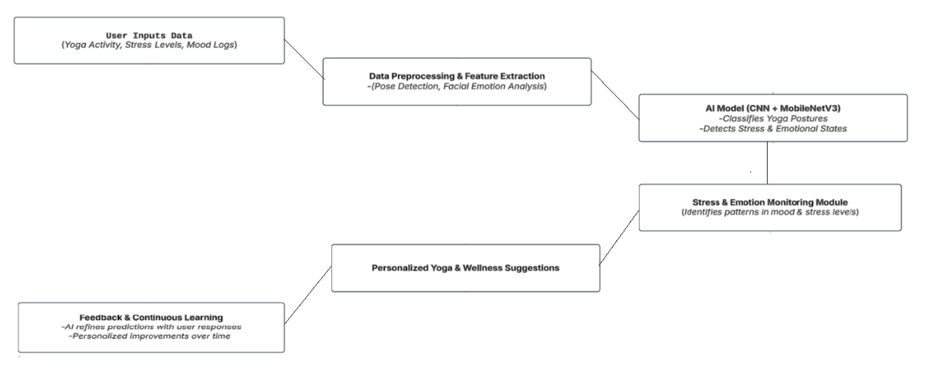
6. PROPOSED METHODOLOGY :

Slide 8
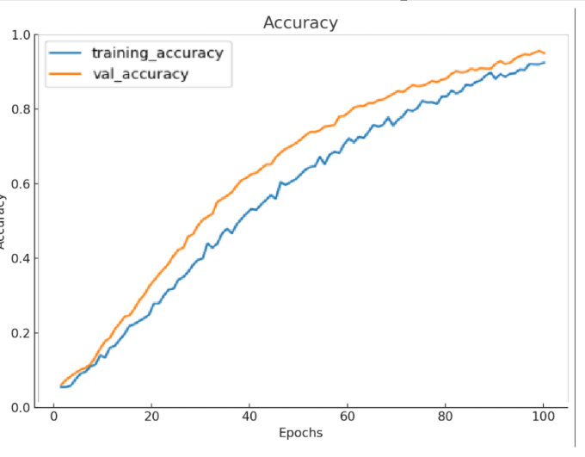
7. RESULTS & DISCUSSION:
We achieved a 95% validation accuracy,
showing strong predictive capability.
Precision, recall, and F1-score were high
across all 43 yoga pose categories.
Thanks to MobileNetV3’s lightweight architecture, our system is fast and suitable for smartphones, with a response time of just 85 milliseconds.

Slide 9
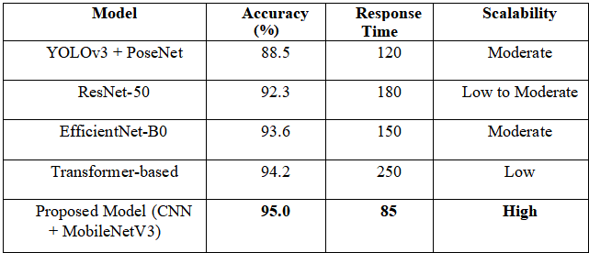
8. COMPARATIVE ANALYSIS:

Slide 10
9. CONCLUSION & FUTURE WORK :
The proposed Yoga-AI framework effectively tracks stress and emotion in real-time.
Combines transfer learning with traditional wellness practices.
Highly accurate, scalable, and ideal for mobile applications.
Future Scope:
Expand dataset diversity
Deploy on edge devices
Explore other architectures (e.g., Vision Transformers)

Slide 11
10. REFERENCES :
[1]Vijaya Raghava Duppala, Harika Yadav Marepalli, Kirti Jain S, Koduru Anusha, Senthil Kumar Thangavel, B Senthil Kumar, Avadhani Bindu, Latha Satish, Jeeva Sekar (2024). Aatma Yoga: Automation of Yoga Pose Recognition and Recommendation using Deep Learning. https://doi.org/10.1109/ICICT60155.2024.10544761
[2]Mansoor Hussain, Omkar Prashant Karmaekar, Dhananjay Chauhan, Bitan Malik (2024). Integrating AI-Powered Pose Detection for Holistic Fitness Monitoring: Exploring Traditional Yoga Postures and Exercise Recognition. http://dx.doi.org/10.13140/RG.2.2.35702.82243
[3]Eleni Mitse, Athanasios Drigas, Charalabos Skianis (2024). Artificial Intelligence, Immersive Technologies, and Neurotechnologies in Breathing Interventions for Mental and Emotional Health: A Systematic Review. https://doi.org/10.3390/electronics13122253

Slide 12
10. REFERENCES :
[4]Vijaya Raghava Duppala; Harika Yadav Marepalli; Kirti Jain S; Koduru Anusha; Senthil Kumar Thangavel; B Senthil Kumar, Avadhani Bindu, Latha Satish, Jeeva Sekar (2024). Aatma Yoga: Automation of Yoga Pose Recognition and Recommendation using Deep Learning. https://doi.org/10.1109/ICICT60155.2024.10544761
[5]M Darshan, Appu V, Rohan M, Nandan N, Nandita Bangera (2023). Real Time Yoga Asana Recognition using Deep Learning.
[6]Deepak Kumar, Anurag Sinha (2020). Yoga Pose Detection and Classification Using Deep Learning. https://doi.org/10.32628/cseit206623
[7]S. Sankara Narayanan, Devendra Kumar Misra, Kartik Arora, Harsh Rai (2021). Yoga Pose Detection Using Deep Learning Techniques. https://dx.doi.org/10.2139/ssrn.3842656

Slide 13
10. REFERENCES :
[8]Shubham Santosh Rokade, Suyash Machhindra Kamble, Parth Santosh Kshirsagar, Anish Janardhan Kakar, Prof.K.S.Hangargi (2024). YOGA ASSISTANT: A YOGA POSTURE DETECTION & CORRECTION SYSTEM.
[9]Santosh Kumar Yadava,b,∗, Apurv Shuklac,∗, Kamlesh Tiwarid , Hari Mohan Pandeye , Shaik Ali Akbar (2023). An Efficient Deep Convolutional Neural Network Model For Yoga Pose Recognition Using Single Images.
[10]Prof. Minal Zope, Swapnil Prasad, Omkar Patil, K.M. Chintguntla(2023). Yoga Pose Detection Using Deep Learning.
[11]Vivek Anand Thoutam,1 Anugrah Srivastava,1 Tapas Badal, Vipul Kumar Mishra, G. R. Sinha, Aditi Sakalle , Harshit Bhardwaj and Manish Raj (2022).Yoga Pose Estimation and Feedback Generation Using Deep Learning. https://doi.org/10.1155/2022/4311350

Slide 14
10. REFERENCES :
[12]Seonok Kim. 3DYoga90: A Hierarchical Video Dataset for Yoga Pose Understanding.
[13]Manisha Verma1, Sudhakar Kumawat, Yuta Nakashima, Shanmuganathan Raman (2020). Yoga-82: A New Dataset for Fine-grained Classification of Human Poses.
[14]Jothika Sunney (2022). Real-Time Yoga Pose Detection using Machine Learning Algorithm.
[15]Dr.Somlata Jha, Prakhar Singh, Siddhant Rajhans (2024). Yoga and Artificial Intelligence: A Review of The Potential Applications of AI in Yoga Research and Practice for Neurological Disorders.
[16]Satisha C., Mehra R., Giri M., "Detection of Various Security Attacks on IoT Devices using Machine Learning," in 2023 International Conference on Computational Intelligence and Networks, 2023, doi: 10.1109/ICCINS58907.2023.10450058.

Slide 15
10. REFERENCES :
[17]Badoni P., Walia R., Mehra R., "Enhancing Waste Separation and Management Through IoT-based Smart Bin System," in Proceedings - 2024 1st International Conference on Intelligent Systems and Technologies for Emerging Markets (ISTEMS), 2024, doi: 10.1109/ISTEMS60181.2024.10560260.
[18]Kunadharaju H.P.R., Sandhya N., Mehra R., "Multi sensor image matching using super symmetric classifiers," in International Journal of Recent Technology and Engineering, vol. 8, no. 2, pp. 6161-6166, 2019, doi: 10.35940/ijrte.B3764.078219.
[19]Badoni P., Walia R., Mehra R., "Wearable IoT Technology: Unveiling the Smart Hat," in Proceedings - 2024 1st International Conference on Intelligent Systems and Technologies for Emerging Markets (ISTEMS), 2024, doi: 10.1109/ISTEMS60181.2024.10560229.

Slide 16
10. REFERENCES :
[20]Vijay Krishnan M.R., Mehra R., Kunadharaju H.P.R., "Design of Neural Network based Approaches for Image Processing," in 2024 3rd International Conference on Electrical, Electronics, and Information Communication Technology (ICEEICT), 2024, doi: 10.1109/ICEEICT61591.2024.10718442.

